Slide 1
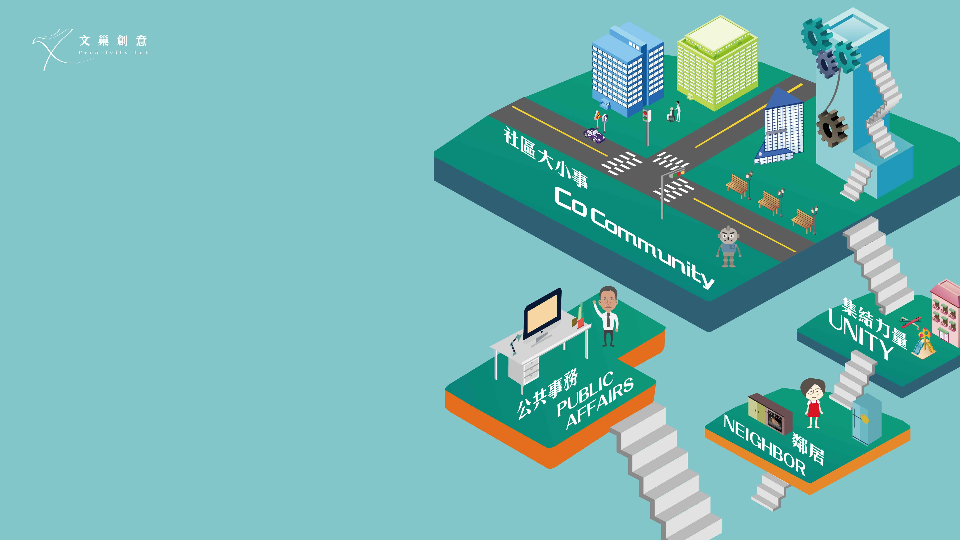

Community Sharing Platform
This app combines the power of neighbors
to create strong and tighter communities.
This platform combines the power of neighbors
to create strong and tighter communities.
Combines the power of neighbors
to create strong and tighter communities.

Slide 2

Original interaction?
people help each other
Restore
Home care
Produce
Food

Slide 3

After Mobile Tech?
people can live alone nowadays
Being alone is a choice，
but to end ,you will have no choice.
Online
Social Activities
AI chat
Home delivery
Home care
Work from home
Food delivery

Slide 4
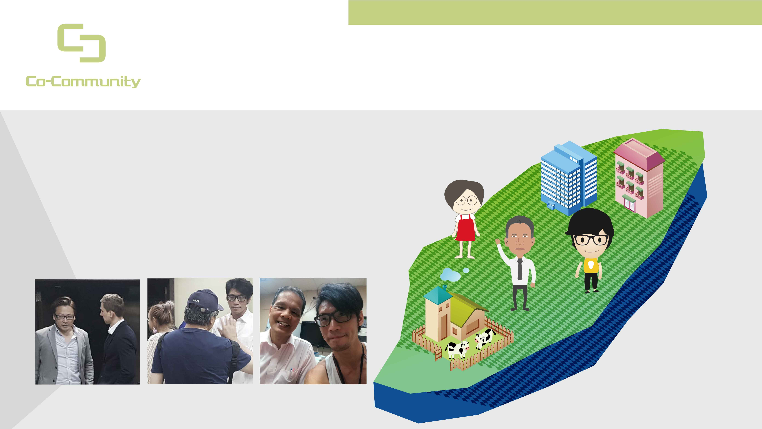
Cooperate? Why now?
people are the source of power, not technology
We discover and collect the power of community.
knowledge
Opinion gathering
Buying power
Human resource
Resource share

Slide 5

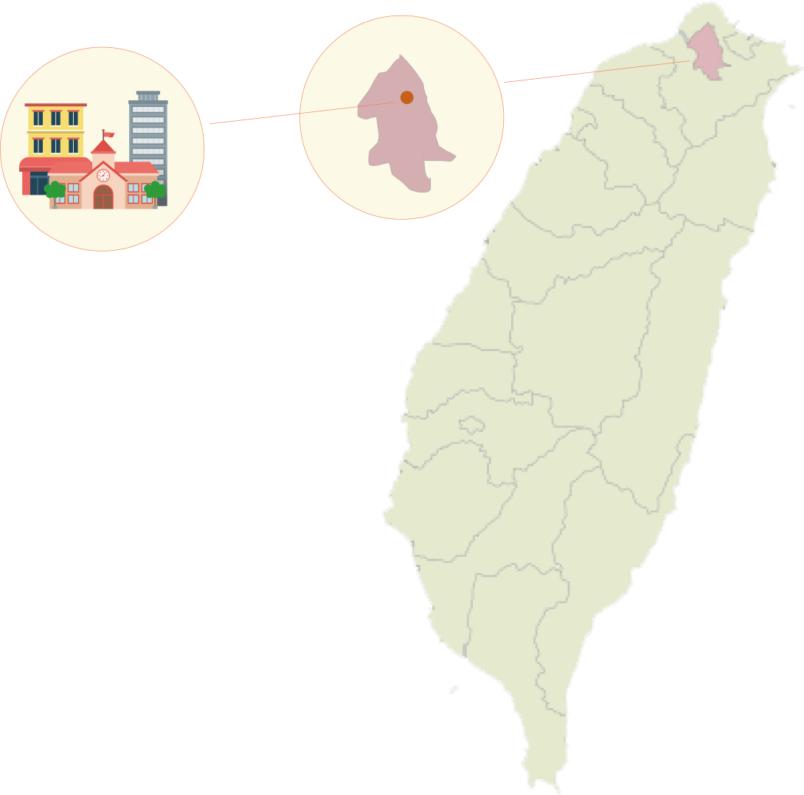
What is our priority?
At least 5 minutes a day for truly localized information
Enhance care of living environment and local culture
Living circle
Other remote locations
Everything we should know or do in our own community, centralized
Irrelevant to our daily lives

Slide 6

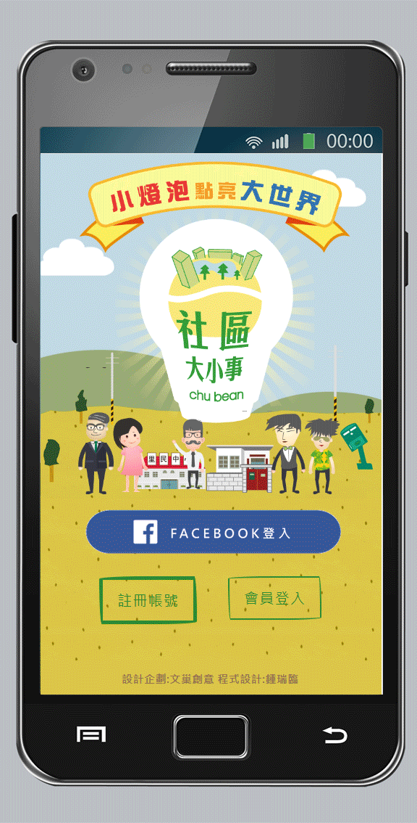
Our solution
with the help of Co-Community
Simple to use UI / UX
E-commerce platform
Shared Resource
Localized Charity
Focus on elder users

Slide 7

Community =
Easy Access and Trustfulness
Extra income
Households
Extra income
Community
Skill Matching
Community
Group Buying
Community Sharing/Rental
Households
Government
NPOS
Localized
Second Hand
Localized
News & Events
Localized Charity

Slide 8

Bring buying power
assemble the power of community
Ex: Produce
choose place of origin by your own，with no stock
Cheaper than market price 30-40%
5% community coin feedback

Slide 9

Community coin
the beauty is that you are getting involved.
Involving in charities easier
your living circle
donate & purchase
the feedback of system

Slide 10
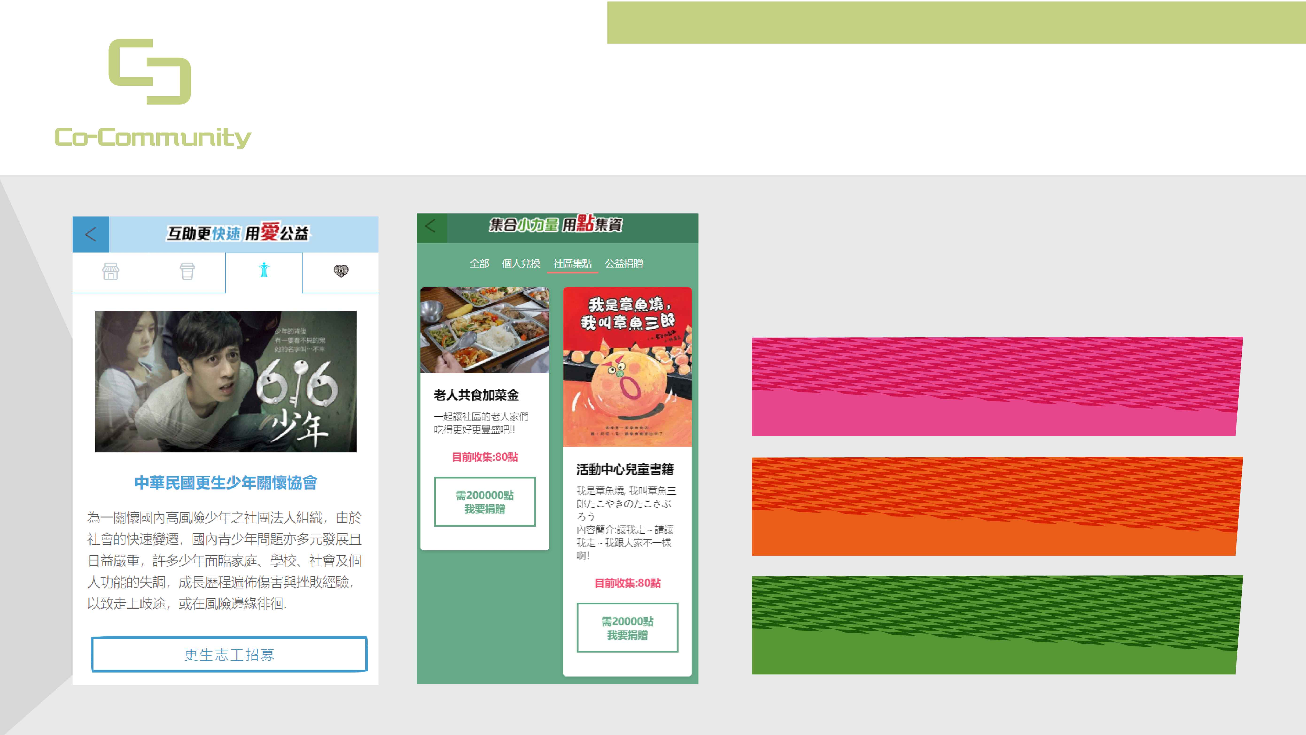
Social Enterprise
Sustainable charity
sunk costs more likely to dedicate
Small Farmer
Community and Charity
Crowd Funding

Slide 11
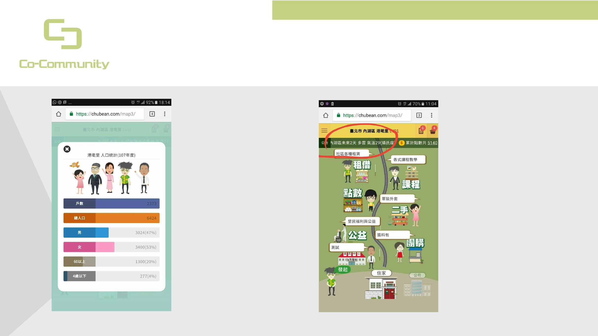
Use Open data
Quickly know life information
population Statistical
weather
If you apply a group buy or class，You can know how big your market is.
Updated every six hours , The weather in your area
使用需求 /村里人口數量
檔案類型 / CSV
資料來源:資訊內政部統計處
https://segis.moi.gov.tw/STAT/Generic/Project/GEN_STAT.ashx?method=downloadproductfile&code=BACF26E3C3F0E0CF16A29E37333D0688&STTIME=107Y06M&STUNIT=U01VI&BOUNDARY=全國&SUBBOUNDARY=
使用需求 /鄉鎮天氣預報
檔案類型 / API
資料來源:氣象局
https://opendata.cwb.gov.tw/api/v1/rest/datastore/F-D0047-089?Authorization=rdec-key-123-45678-011121314

Slide 12
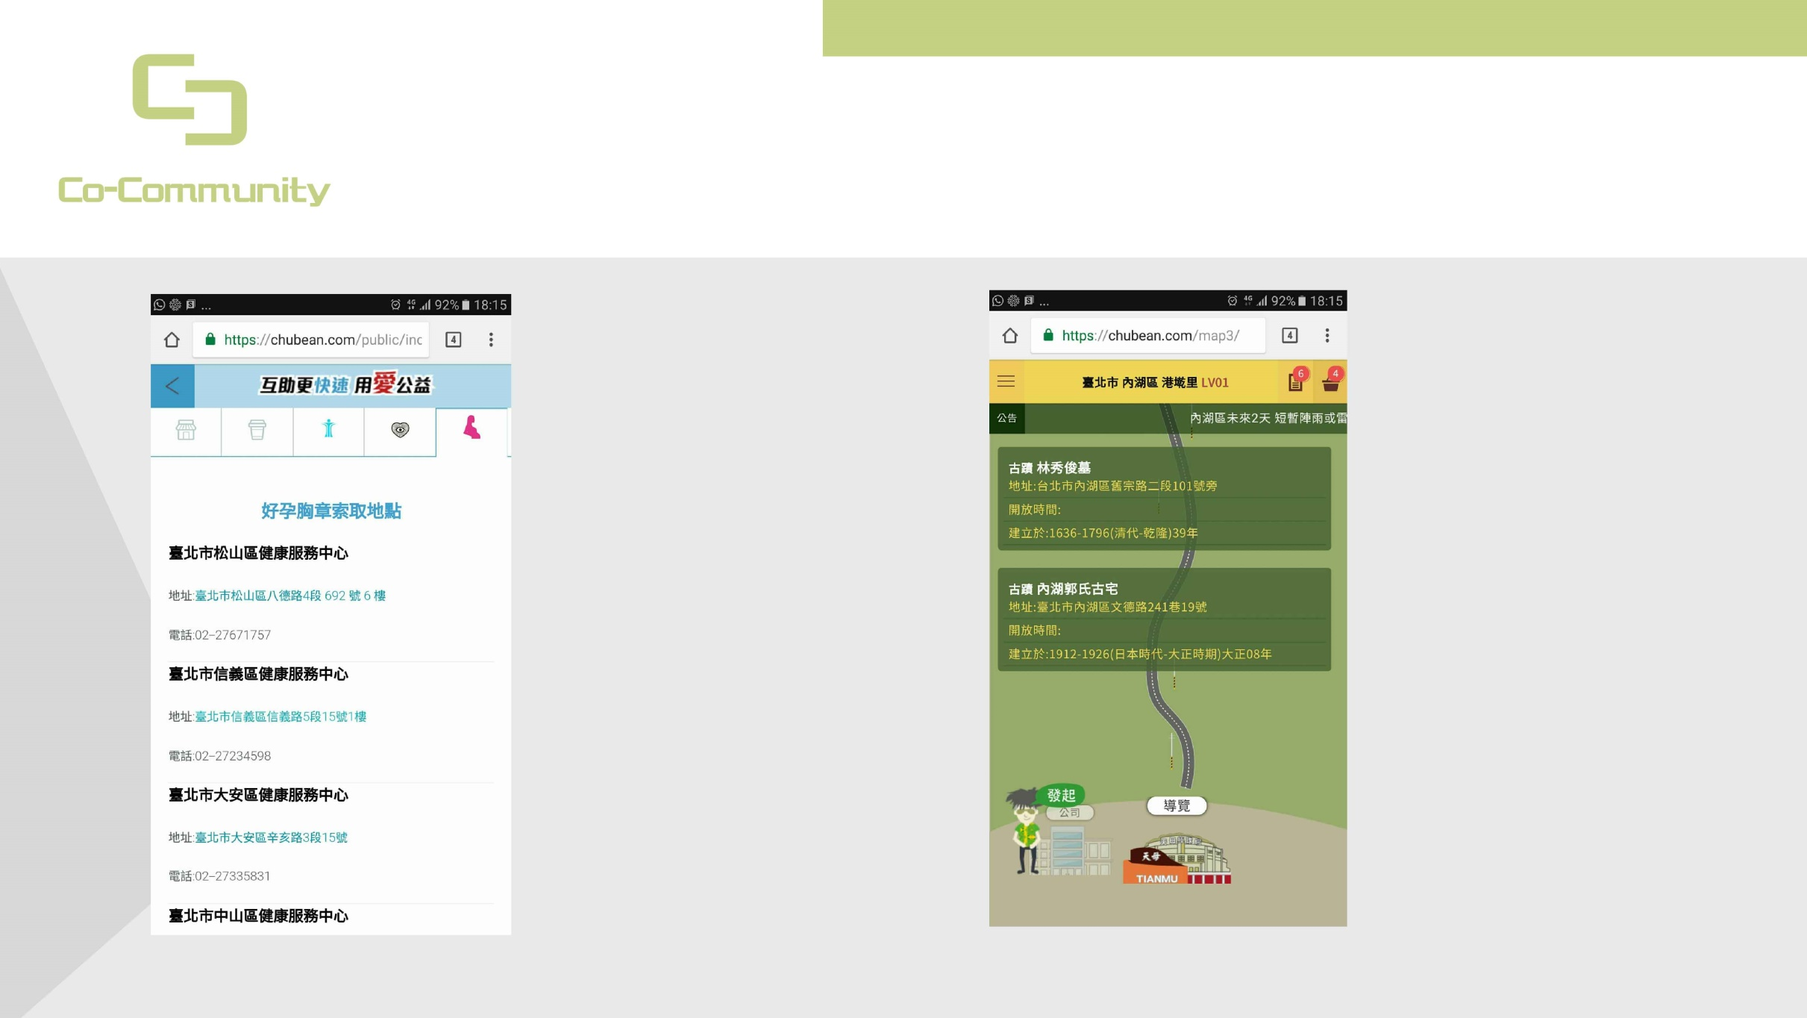
Use Open data
Quickly know life information
pregnancy elder users
local tour
Social welfare about neighbors , Quickly know when and where.
Tourists Can Use the local information , Quickly find Historic Spot.
使用需求 /好孕胸章索取地點及電話
檔案類型 / CSV
資料來源:臺北市好孕胸章https://data.taipei/api/getDatasetInfo/downloadResource?id=e9a28a2d-eb6c-4127-8f7e-1ef6204baf1a&rid=67945251-c1c0-4fee-a500-2c6fbdea16ba
使用需求 /鄉鎮古蹟或文化資訊
檔案類型 / CSV
資料來源:文化資產https://data.tycg.gov.tw/opendata/datalist/datasetMeta/download?id=8e04a93e-bba9-4337-860b-5216d67f152c&rid=b4791892-2bf4-4967-84a3-764bc1f7df45

Slide 13


Slide 14
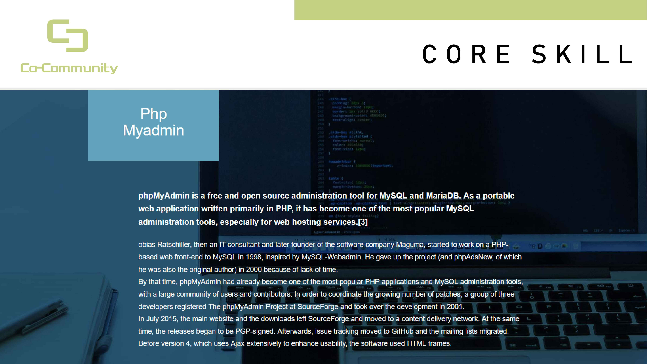

Slide 15
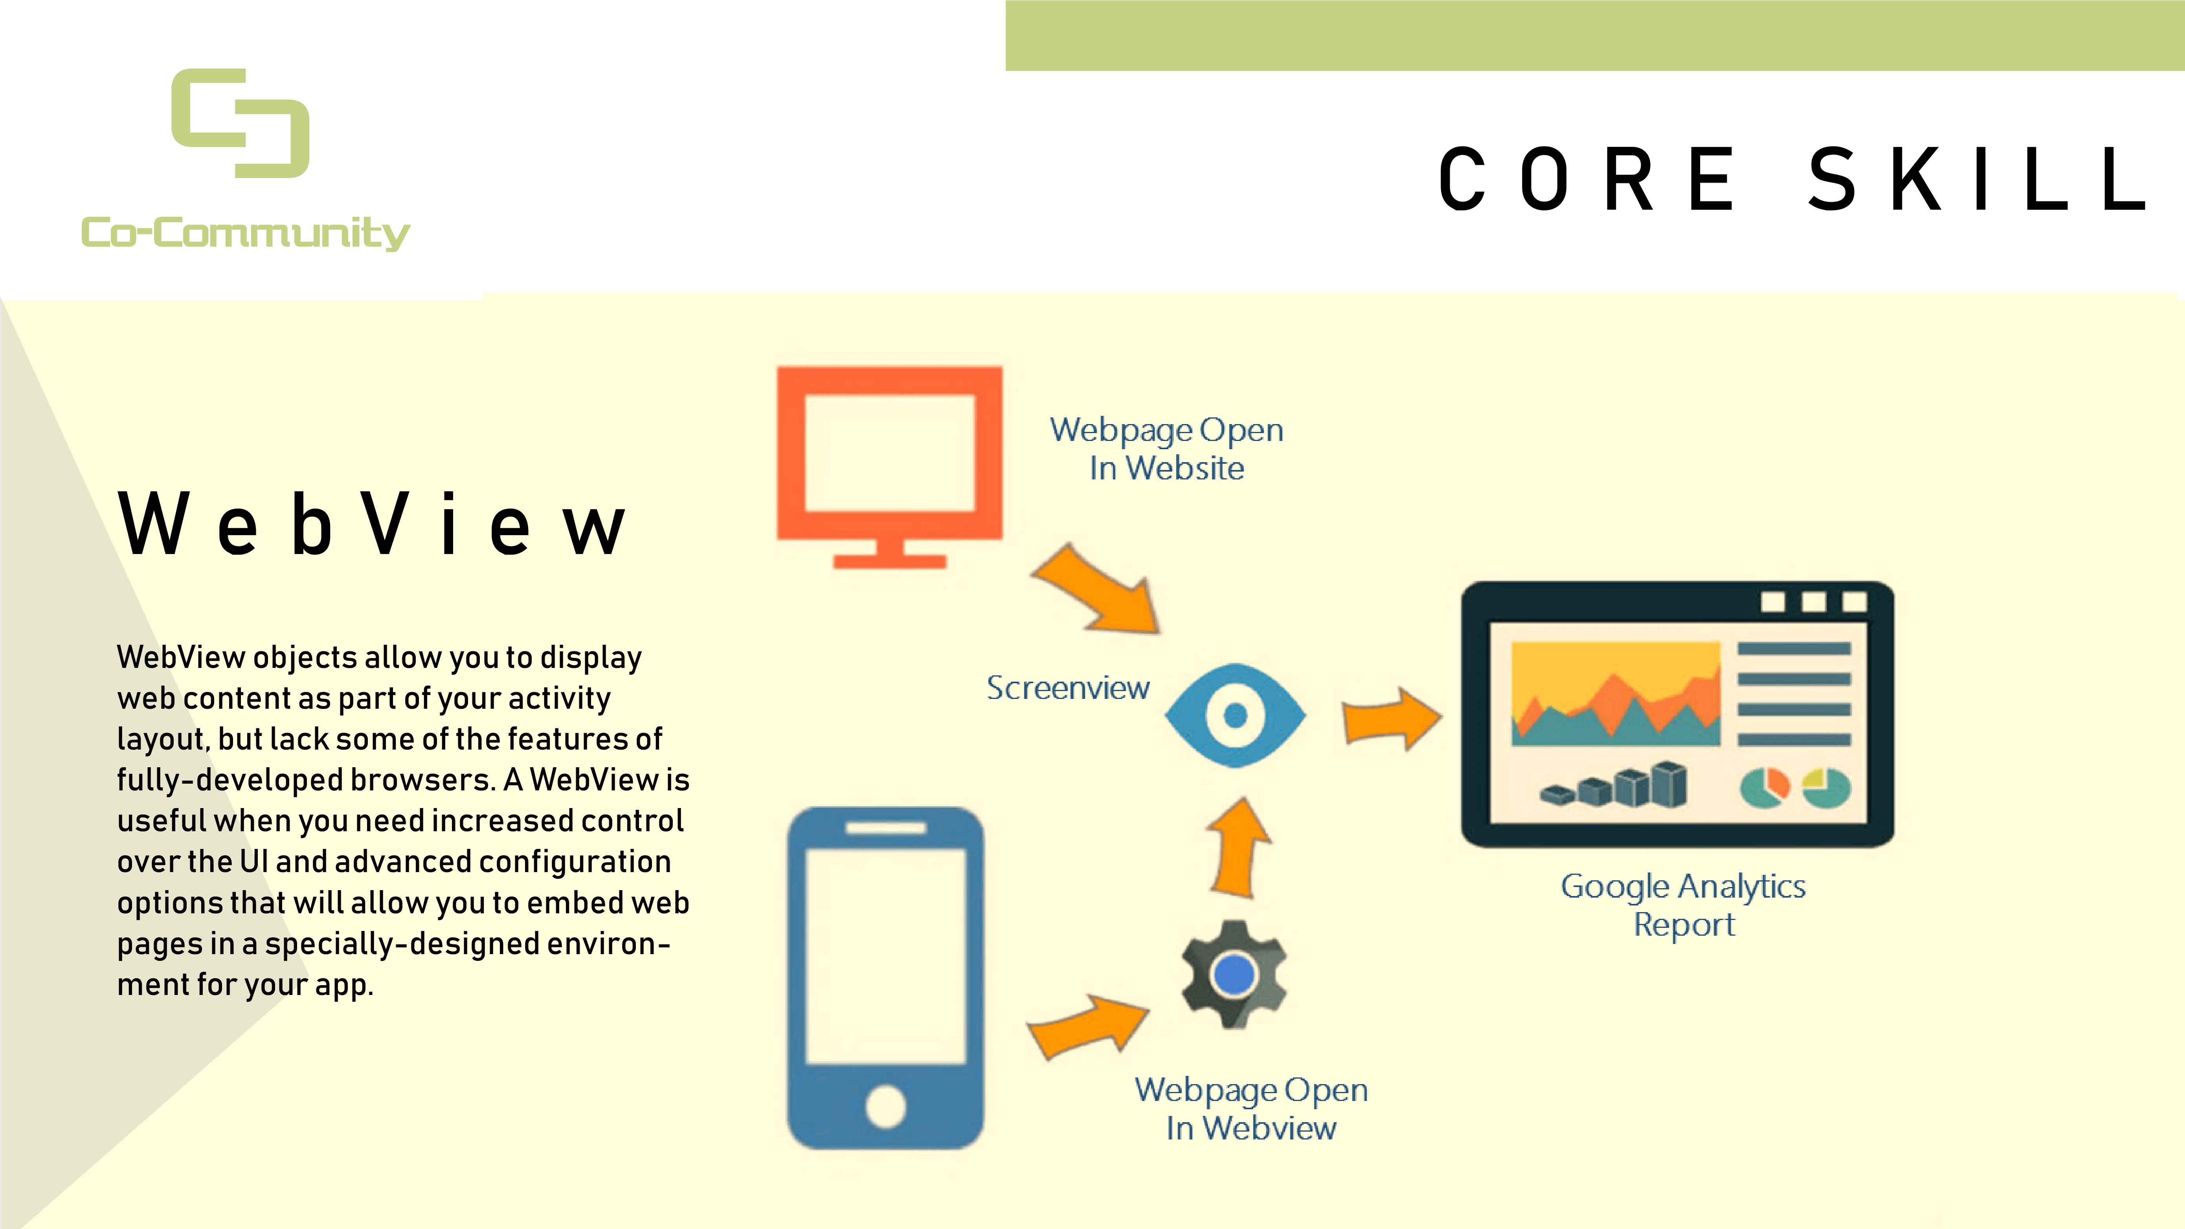

Slide 16
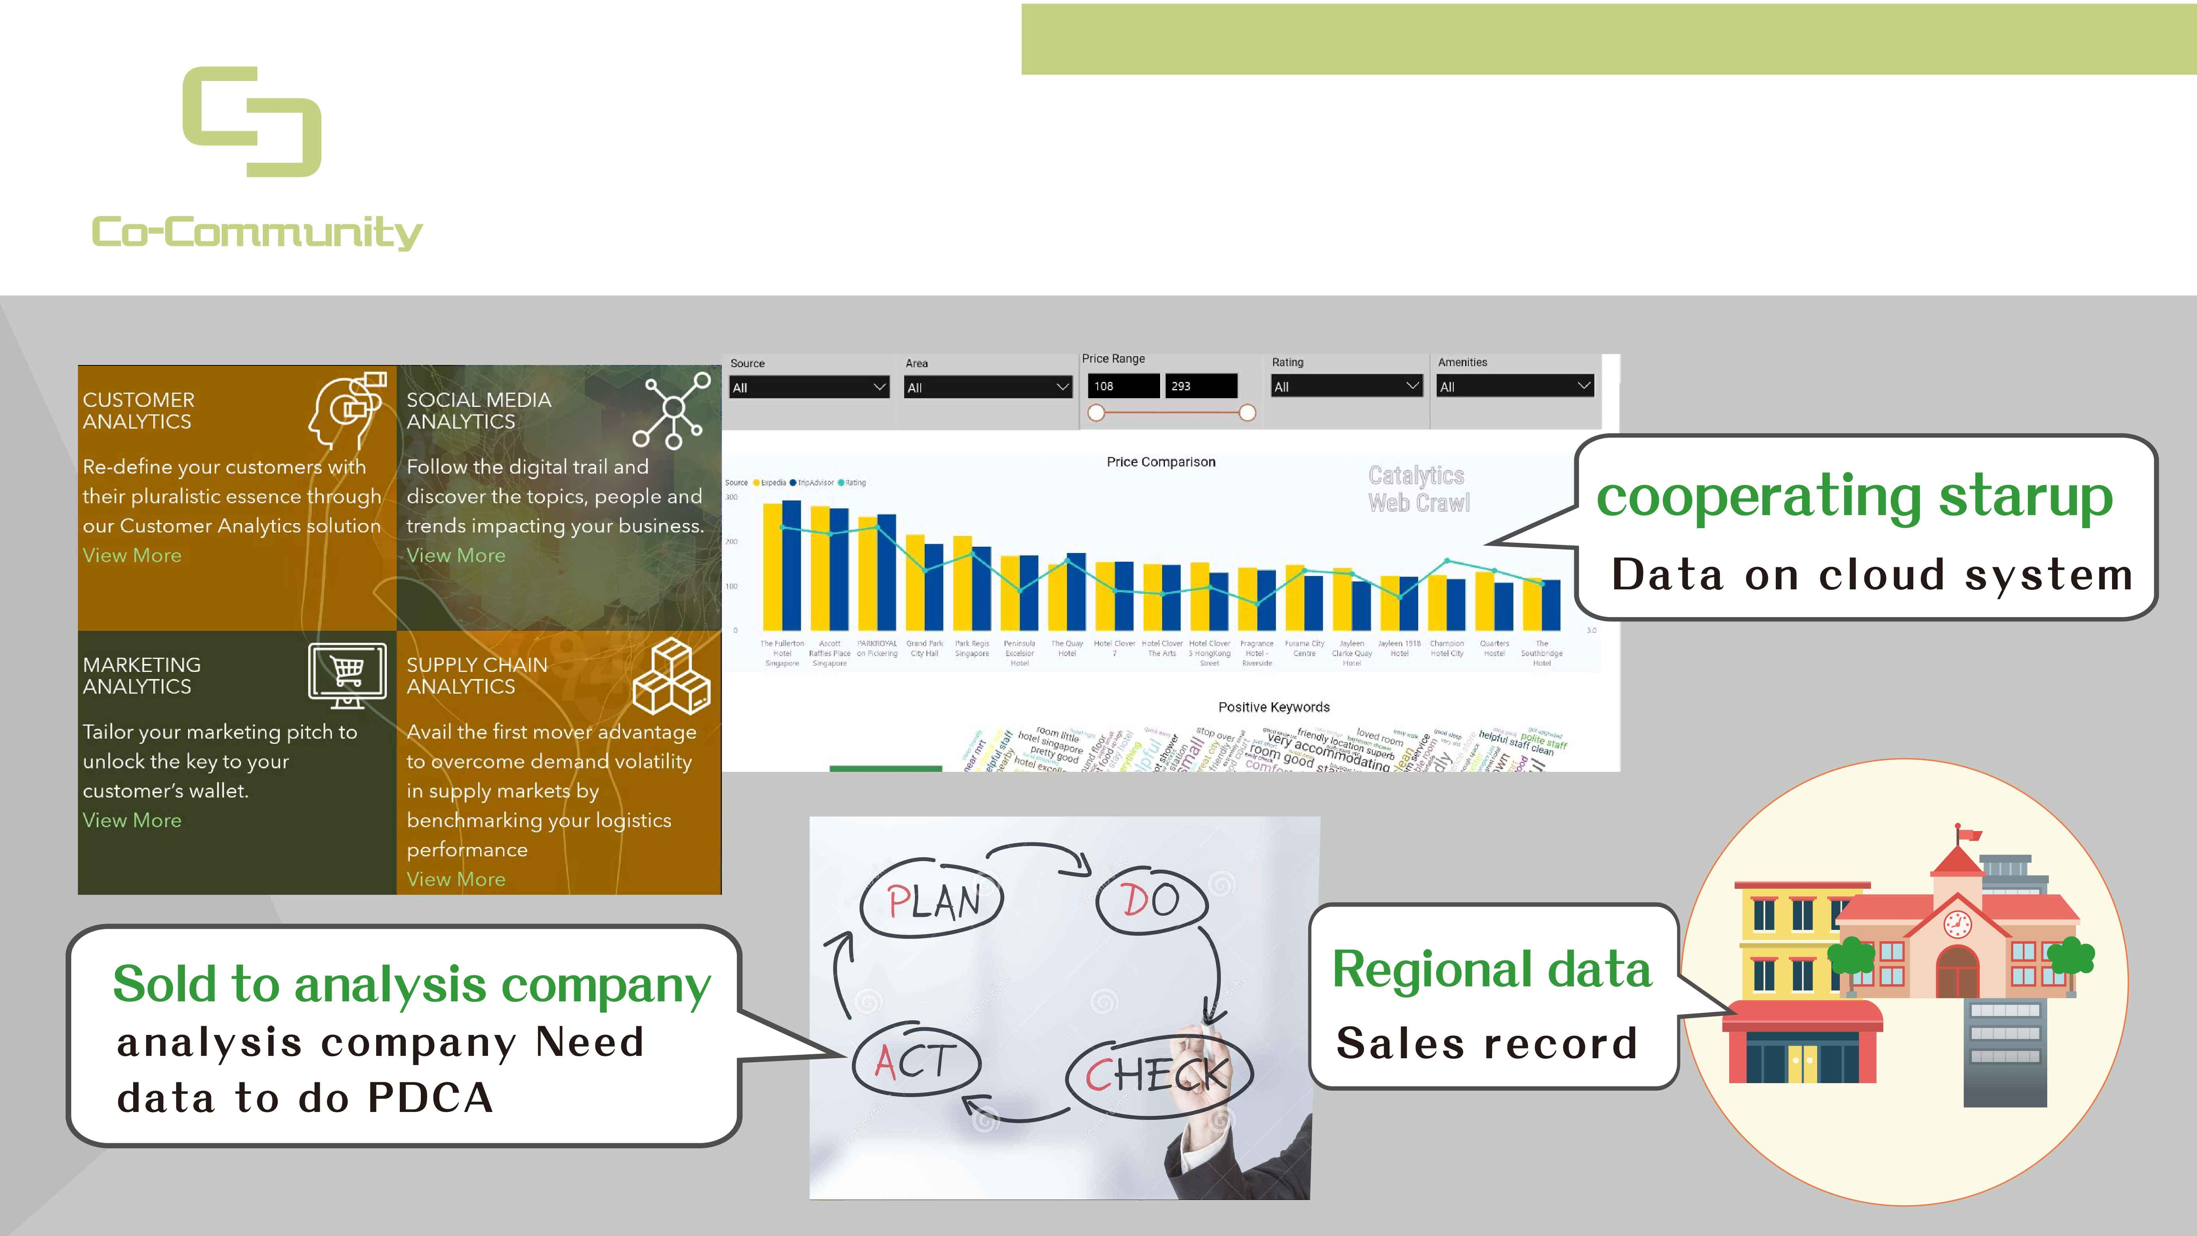
Our big data
Collection and analysis

Slide 17
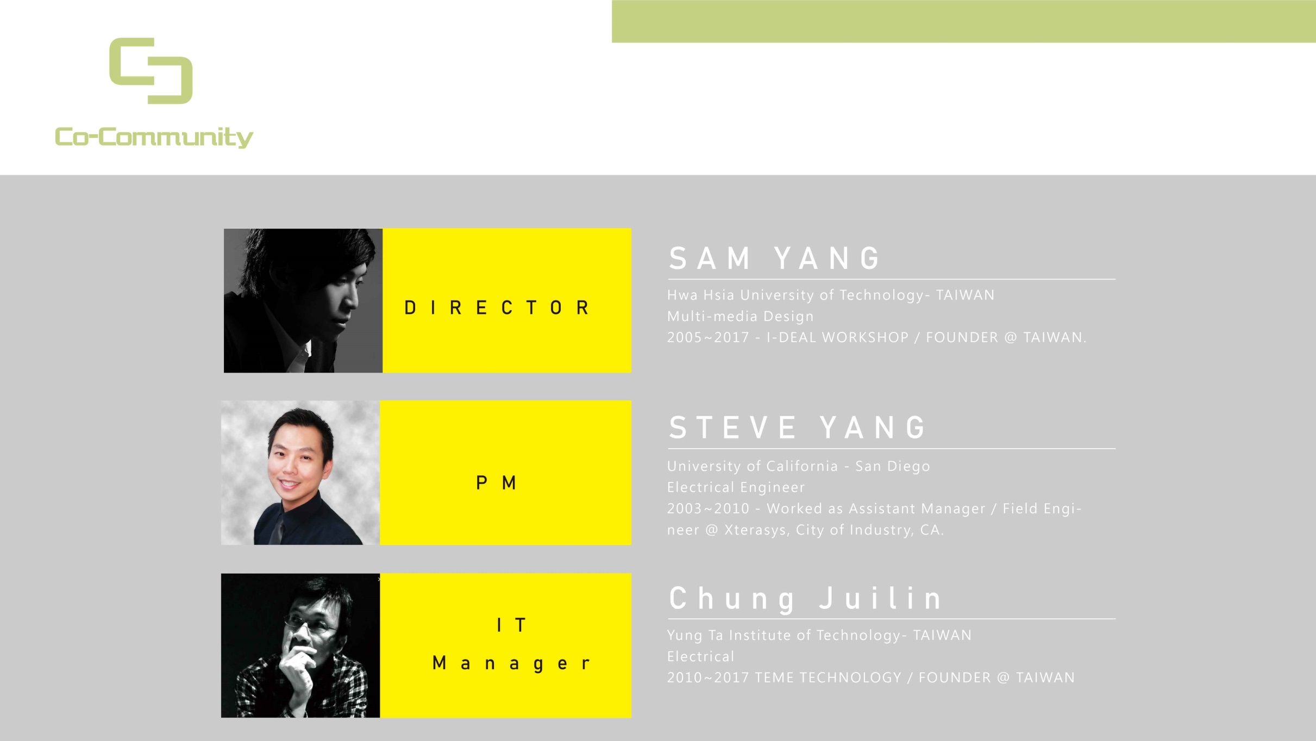
Team
In the past, neighbors always help out each others.

Slide 18
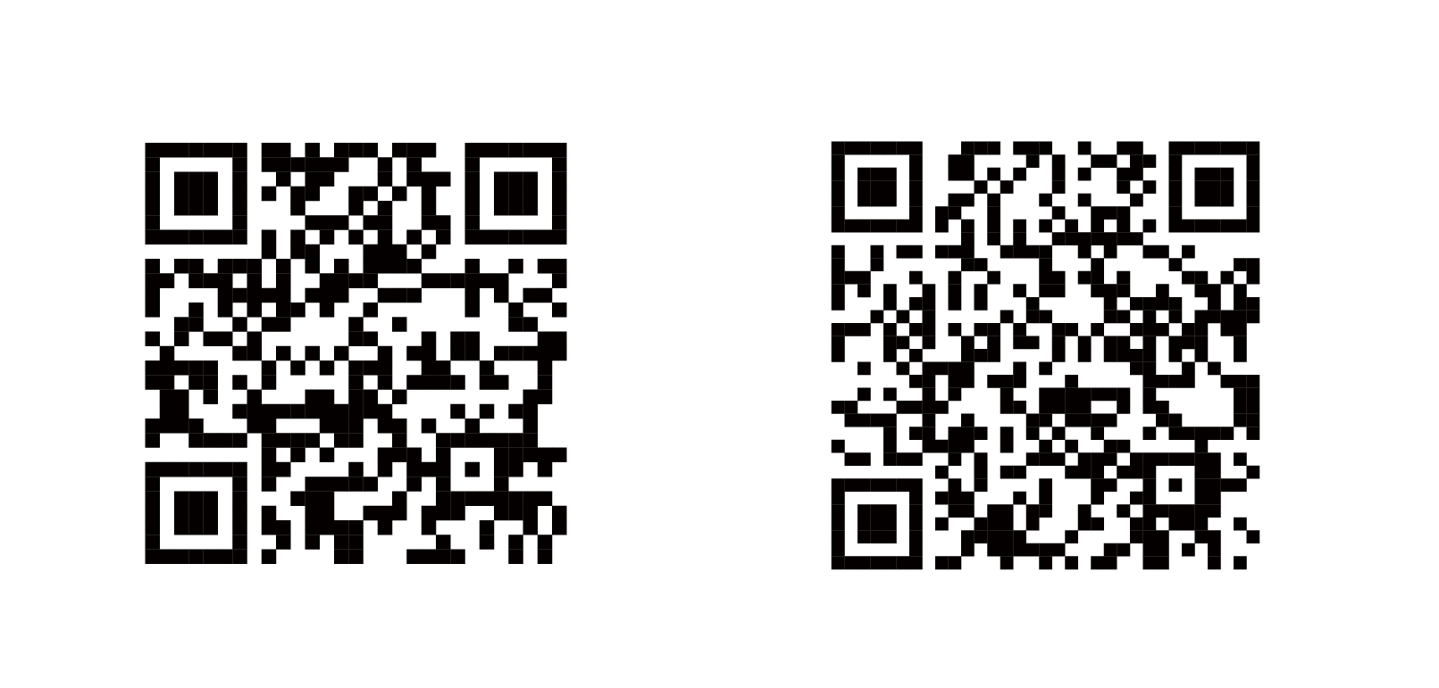

Contact us
When you have taken all you can bear. You can't feel the pain will Rainstorm hits you.
Chinese Website
Video Introduction
Creativity Lab
Line-id: design-sam
WeChat: sam0927000023
sam@i-dealworkshop.com

